Slide 1
SEGY eShopper
BY: Eden Zare Gebrehiywet Tsehaye Simon Weldemichael Yohannes Mulualem

Slide 2
Introduction
SEGY shopping center customers are increasing
So, It’s not possible to handle costumers need manually
The new brand web-based application will help customers engagement.
The system will have administrator, sellers and buyers stockholders.

Slide 3
Actors
Admin
Seller
Buyer

Slide 4
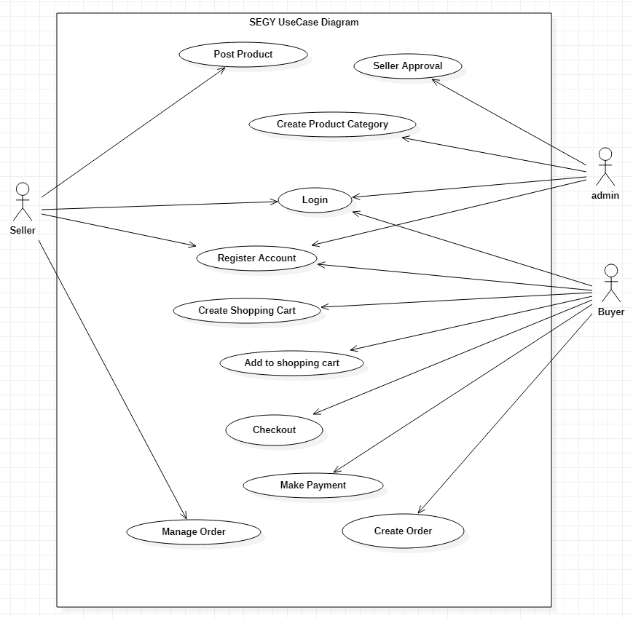
Use Case Diagram

Slide 5
Use Case lists
Login
Admin (CRUD)
Seller(CRUD)
Buyer(CRUD)
Product Category (CRUD)
Product (CRUD)
Creating Shopping Cart
Collecting Items to Cart
Payment (simulation)
Creating Order
Update Order
Generating Receipt
View Order

Slide 6
Admin Activities
Create admin account
Create product categories
Approve seller account

Slide 7
Seller Activities
Create product/ post product
Follow-up his/her ordered product
Manage ordered products

Slide 8
Buyer Activities
Search products
Prepare shopping cart
Collect items to cart
Checkout
Make payment
Generate receipt
Follow-up ordered item

Slide 9
Class Diagram
Click here

Slide 10
E-R Diagram
Click to E-R

Slide 11
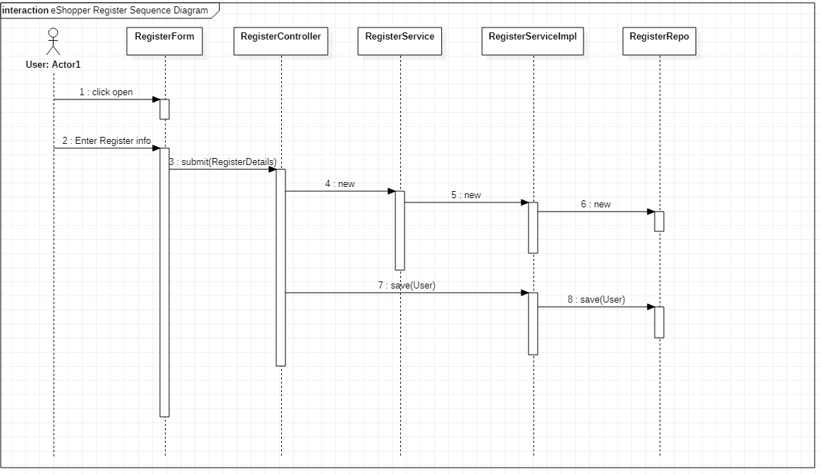
Sequence Diagram
Click to Sequence diagram

Slide 12
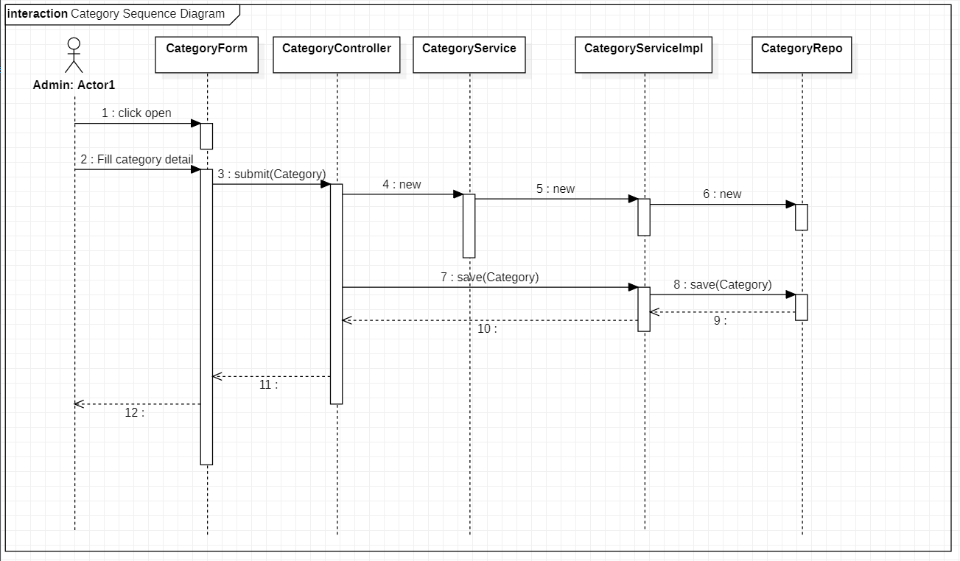
Sequence Diagram

Slide 13
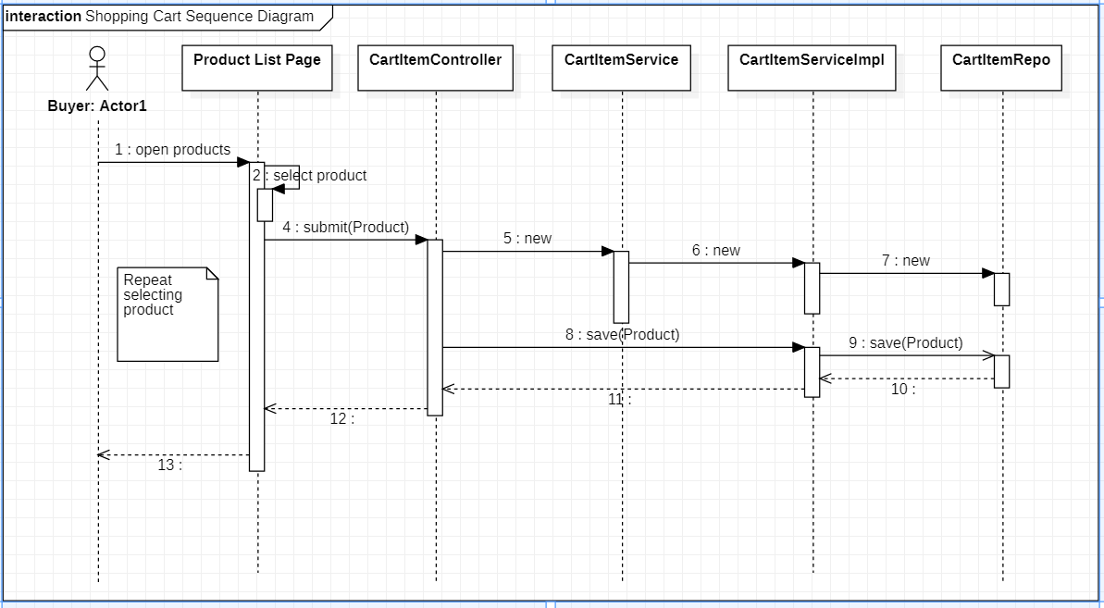
Sequence Diagram

Slide 14
Technologies
Spring Boot 2.3.0
Spring Security
Spring Data
Thymeleaf
JavaScript
CSS
H2 – database

Slide 15

Thank you!

Slide 16
Demo
Demo will continue

